Slide 1
Community Helpers
Citizens of our community!

Slide 2
Who are community helpers?
A community helper is a person who provides a service, using a skill or learned training, within our community.
In your words: ______________________________________________________
____________________________________________________________________
____________________________________________________________________.

Slide 3
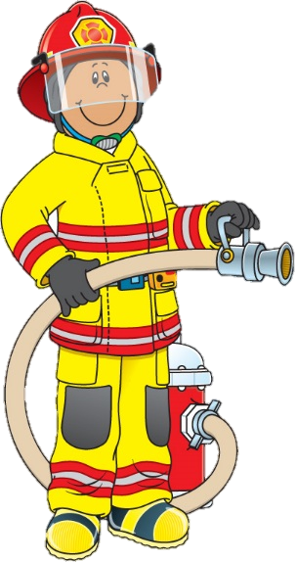
Protection & Safety
Firefighter
Police Officer
Definition: A person that has been trained to prevent and extinguish fires
Location: local fire halls, burning buildings
Tools:
Others: Coast Guard,
Boarder Patrol
Definition: Someone trained to uphold and enforce the law
Location: all populated locations, jails, town halls
Tools:
Others: Detective,
Social Worker

Slide 4
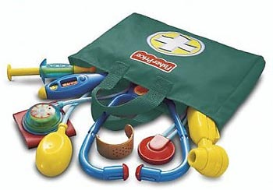
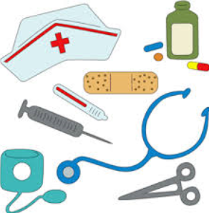
Medical
Nurse
Doctor
Definition: A person who is trained to care for those that are ill or needing medical assistance
Location: hospitals, doctor’s offices, schools, homes
Tools:
Others: Ambulance,
Midwife
Definition: A person who is trained with skills for diagnosing & treating an aliment
Location: hospitals, offices, private locations
Tools:
Others: Dentist,
Specialists, Veterinarian

Slide 5
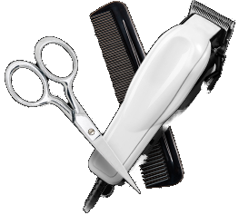
Services
Barber / Beautician
Mechanic
Definition: Someone who cuts or styles hair / make-up, nails, & cosmetic remedies
Location: shops, personal homes
Tools:
Others: Spa
Definition: A person trained to inspect and fix problems with vehicles, machines, or appliances
Location: garages, shops, warehouses
Tools:
Others: Repair technician,
carpenter, engineer

Slide 6
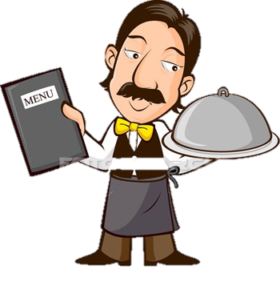
Food Services
Waiter / Waitress
Chef
Definition: Someone who serves customers food and beverages
Location: restaurants, ice cream shops, catered events
Tools:
Others: fast
food servers
Definition: A person who cooks and prepares food
Location: restaurants, catering services
Tools:
Others: baker,
cooks in service
providing locations

Slide 7
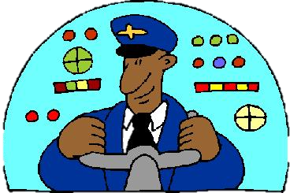
Others
Pilot
Entertainers
Definition: A person who is trained to fly and controls airplanes & helicopters
Location: airports, altitude of 3500 feet
Tools:
Others: Air force,
Mercy flight attendants
Definition: Someone who is paid to entertain viewers
Location: television, radio, Hollywood, movie sets, performing arts centers
Tools:
Others: Singers,
Actors, Comedians,
News Anchors,
Circus

